Slide 1


Slide 2
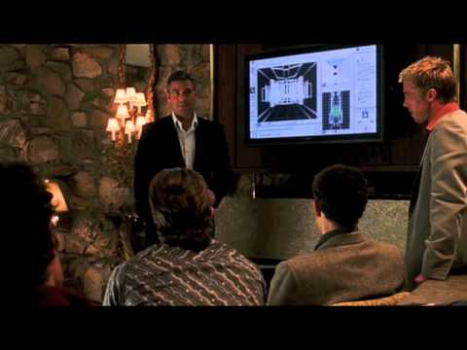
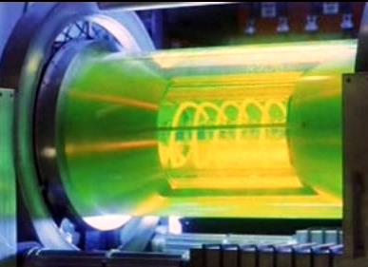
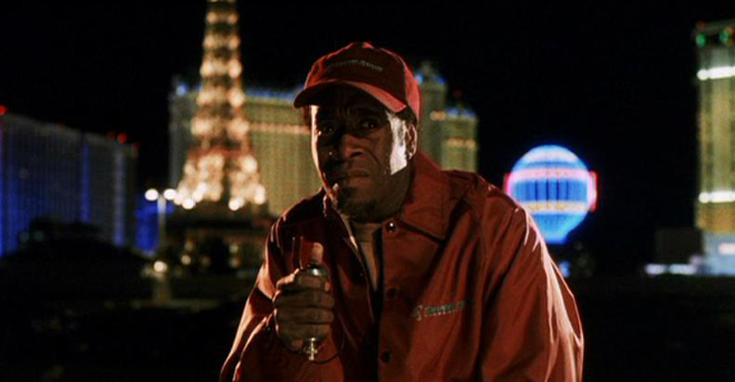
EMC Movie-Oceans’ 11

Slide 3
Chicago Chapter
Chair- Jack Black Vice Chair –Roger Swanberg
Secretary- Jerry Meyerhoff Scholarships-H.R. Hofmann
Programs- Tom Braxton Events-Webmaster- Frank Krozel
Co-Secretary- Denny Barfuss Membership- Mike McNatt
Treasurer- Ray Klouda Publicity- Craig Fanning
EMC Advocate- Roy Leventhal
Education Emeritus-Louann Devine Mlekodaj

Slide 4
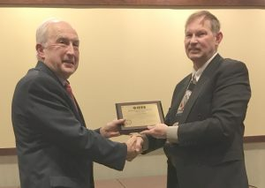
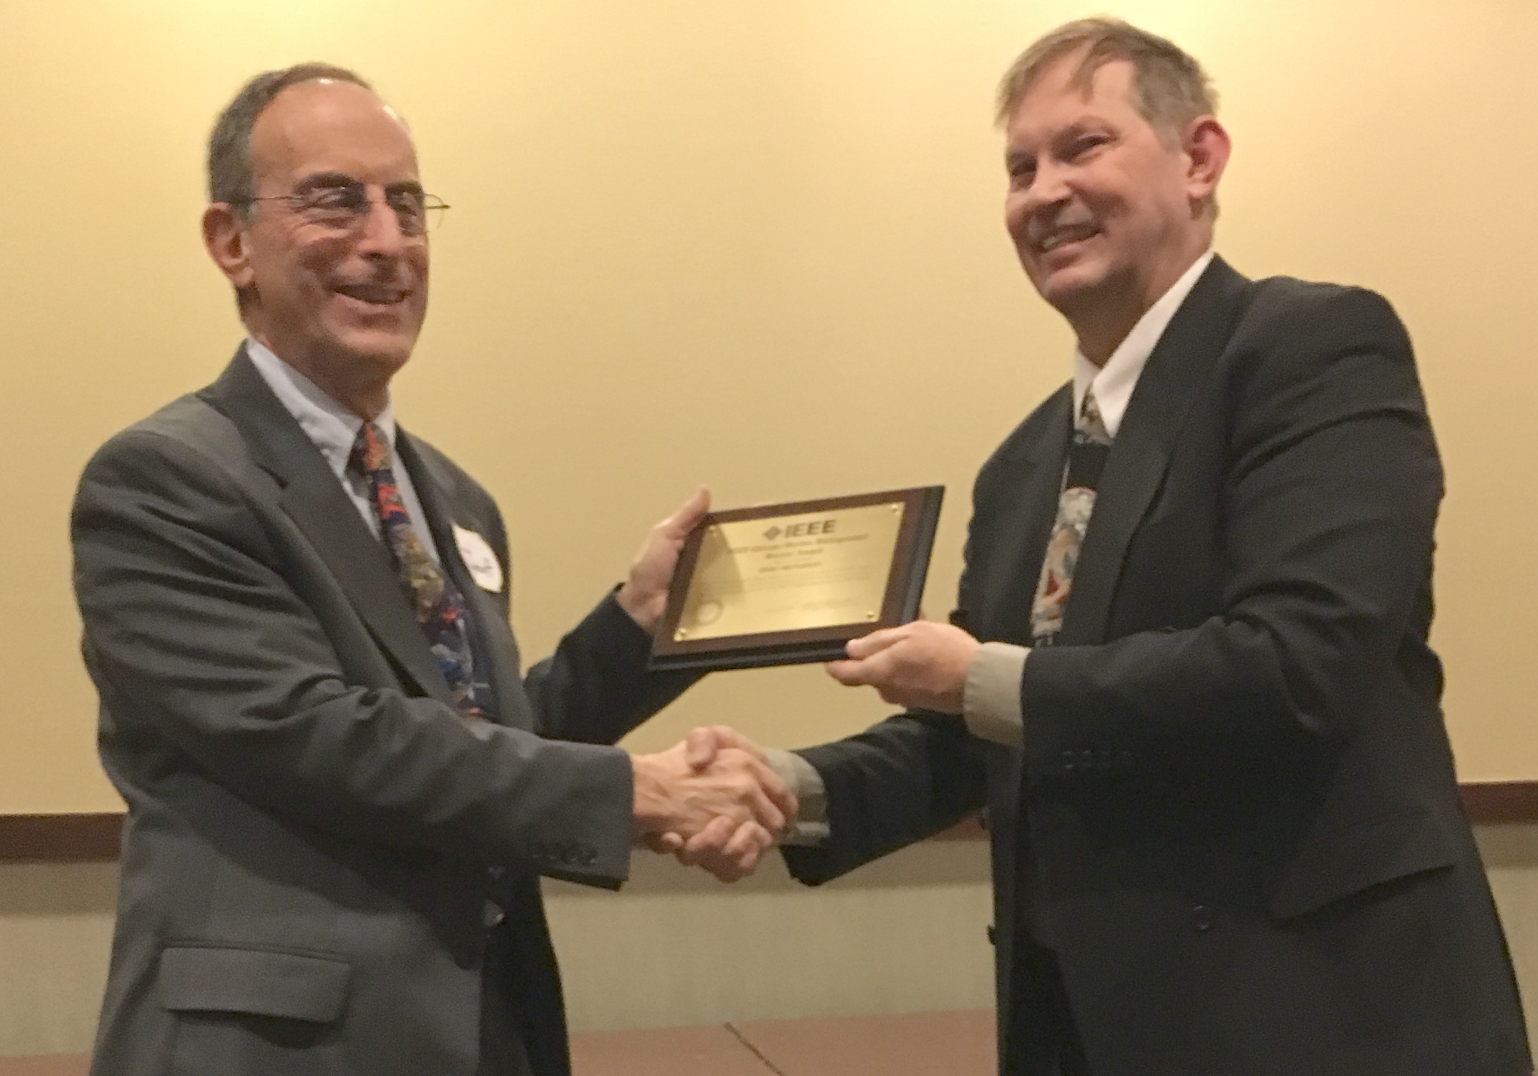
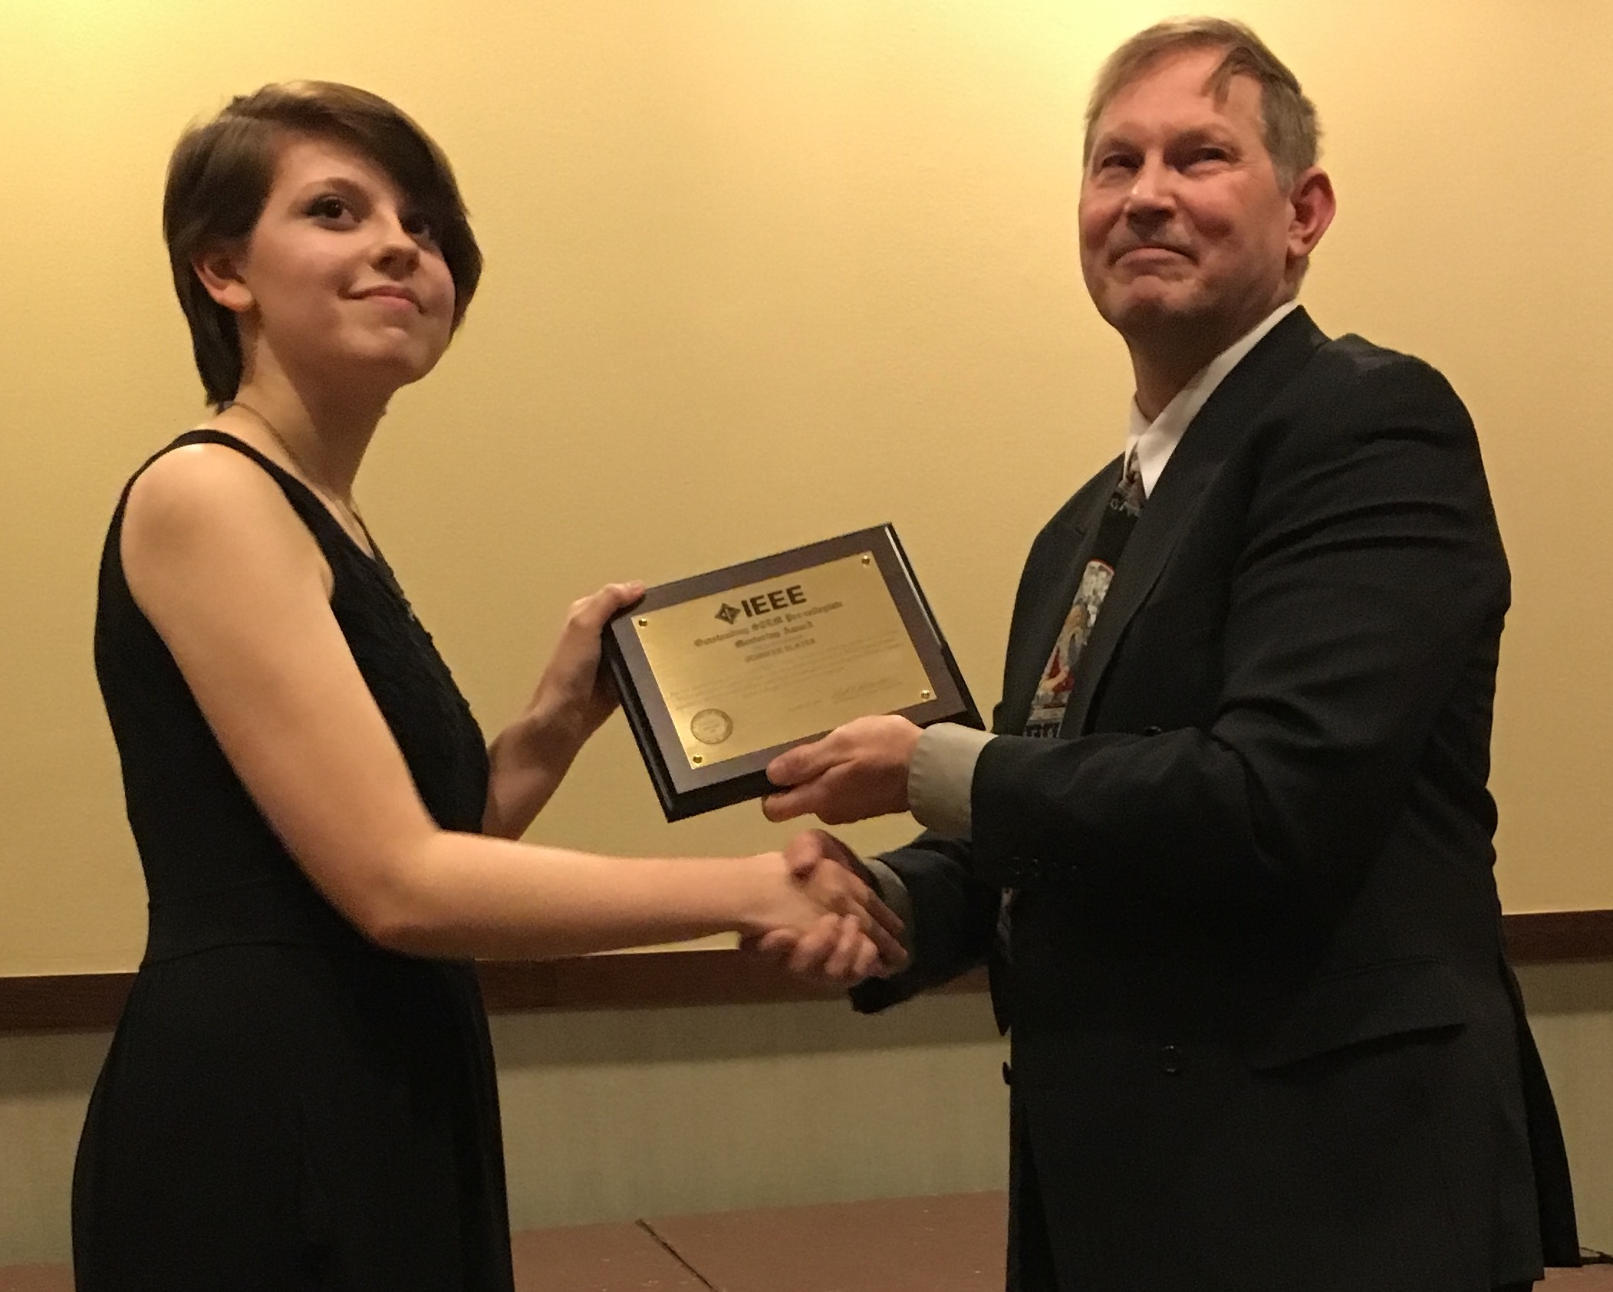
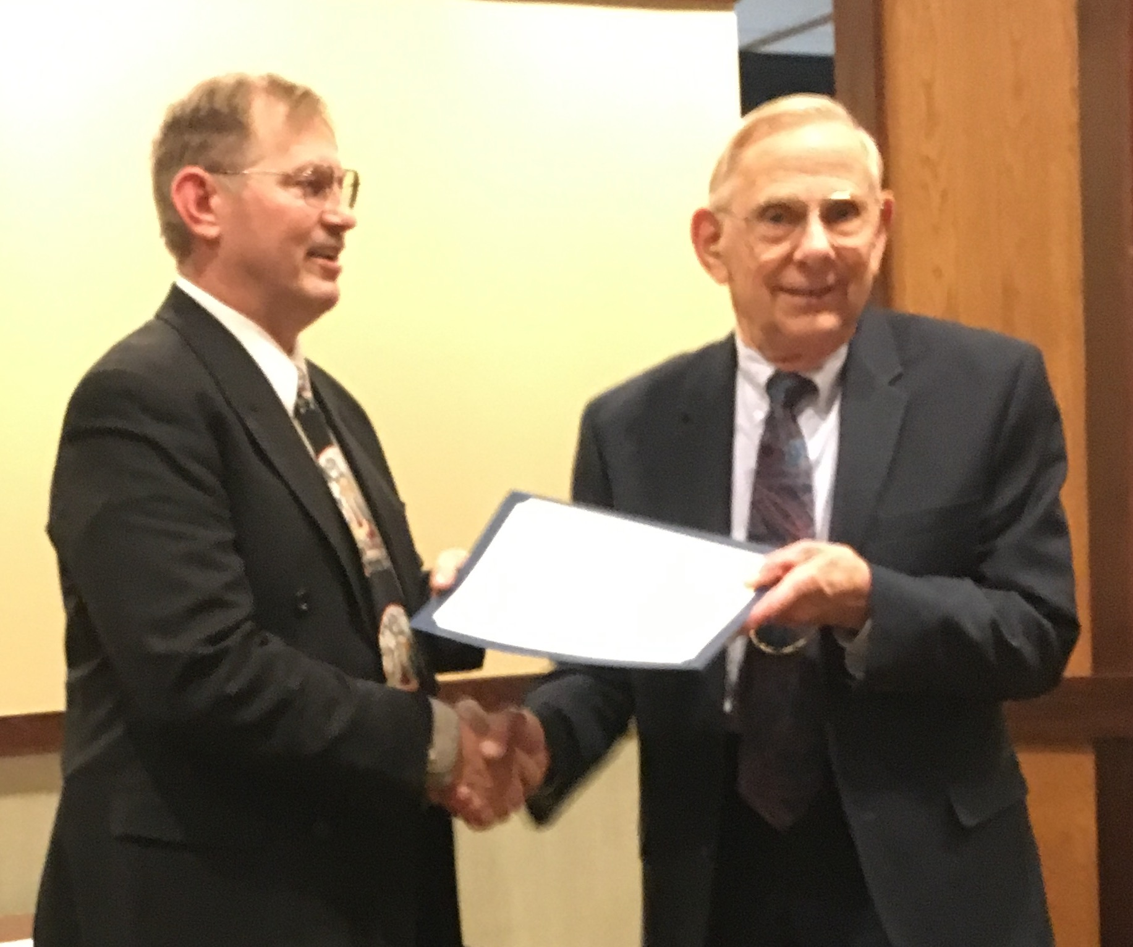
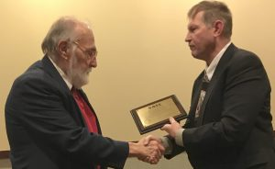
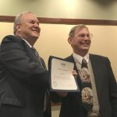
Chicago Section Region 4 Award Winners
Roger Swanberg
Jerry Meyerhoff
Jenny Hofmann
H. Robert Hofmann
Donald Sweeney
Jack Black

Slide 5
Chicago Chapter
7 Chapter Meetings
19th Annual Mini Symposium
Holiday Party
Science Kits for Public Library Program
  Over $ 2000 in donations
Chicago Chapter IEEE EMC Scholarship

Slide 6
Chicago Chapter – The Good
Strong and Versatile Team
Diverse Chapter Meetings
19th Annual Mini Symposium
Support of Outside Programs
  Science Kits for Public Library Program
  Over $ 2000 in donations
Chicago Chapter IEEE EMC Scholarship

Slide 7
Chicago Chapter – Goals
More professional development programs
New membership and new attendees
Increase Student Activities
Expand Chicago Chapter IEEE EMC Scholarship

Slide 8
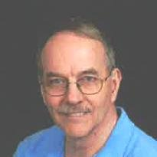
Mike McNatt B and B
September Illinois institute of Technology
Networking: How to Develop This Much Needed Skill
42 Attendees

Slide 9
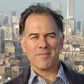
Nick Buris NEBENS, Inc.
October-Annual Oktoberfest Elite Electronic Engineering
Joint Sessions with SAE
Antenna Technology for MIMO Capable Systems
59 Attendees

Slide 10
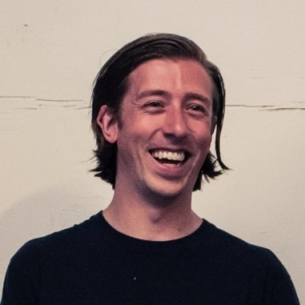
Flynn Lawrence
AR RF/Microwave Instrumentation
November Elmhurst Country Club
The Future In Radiated Immunity Testing
30 Attendees

Slide 11
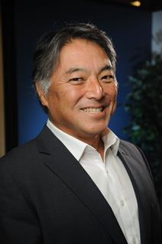
Kris Hatashita Canada Armed Forces
February Illinois Institute Of Technology
Electromagnetic Environmental Effects in the Military
39 Attendees

Slide 12
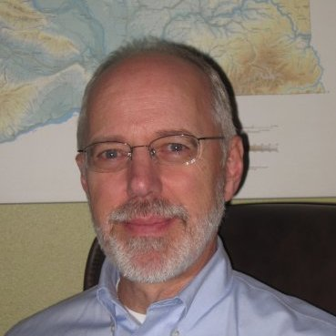
Dave Walen
Chief Scientific and Technical Advisor for Aircraft: Electromagnetic Compatibility, Federal Aviation Administration
March- St. Patrick's Day Presentation Elite Electronic Engineering
Portable Electronic Devices and Aircraft
61 Attendees

Slide 13
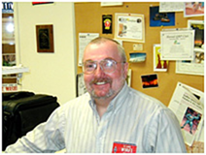
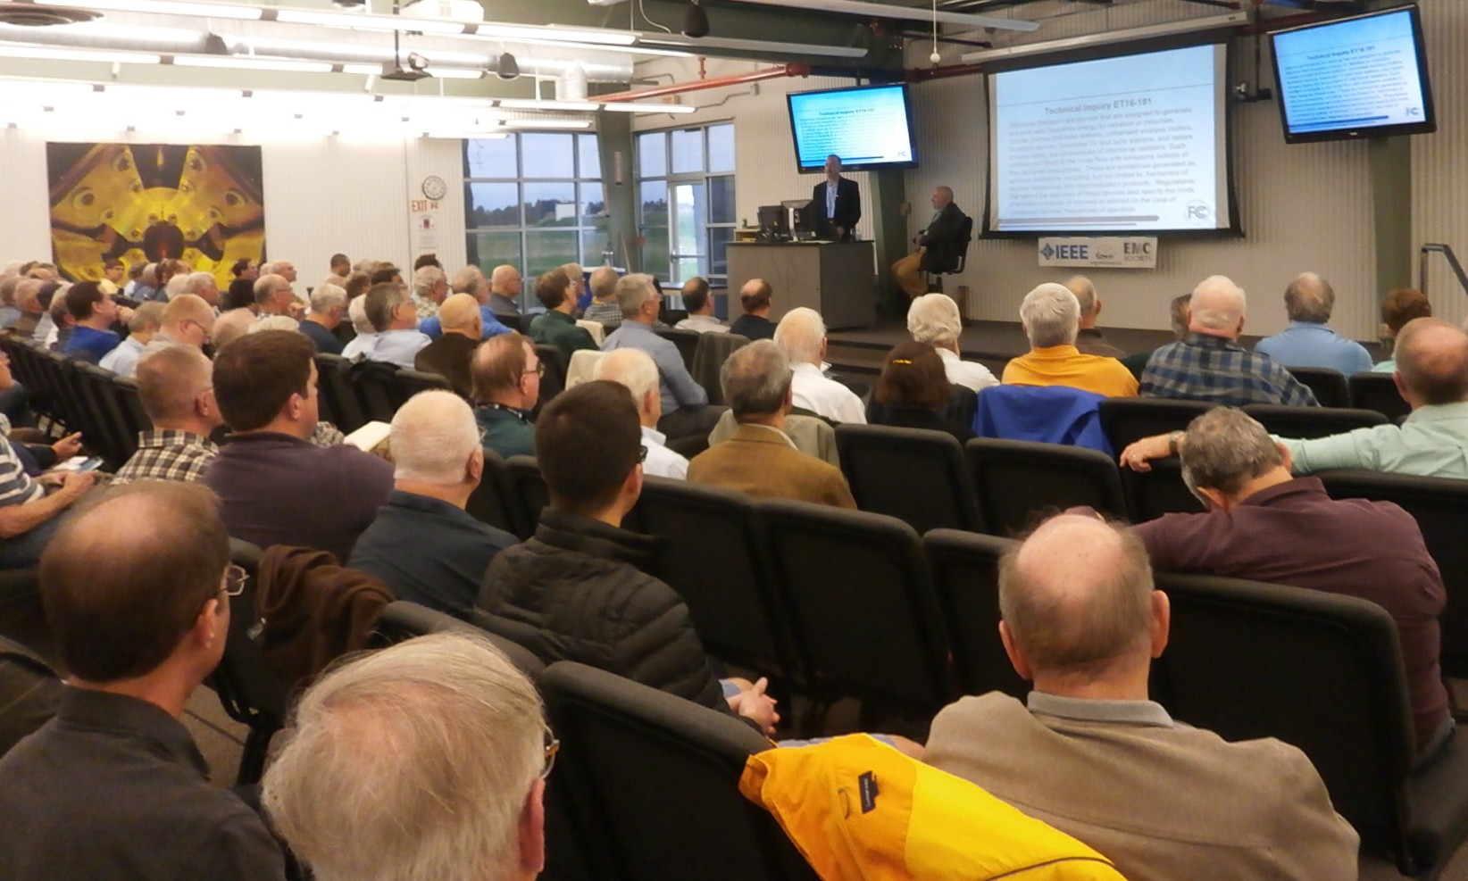

April
Fermi National Laboratory Batavia, IL
Man-Made Noise and the Impact to Radio Communications – The Changing Environment
172 Attendees
Joint Meeting with ARRL
Ed Hare (W1RFI) IEEE Vice-President of Standards and American Radio Relay League Laboratory Manager.
Greg Lapin (N9GL) - Co-chair of the Spectrum and Receiver Performance Working Group of the Federal Communications Commission (FCC) Technological Advisory Council.

Slide 14
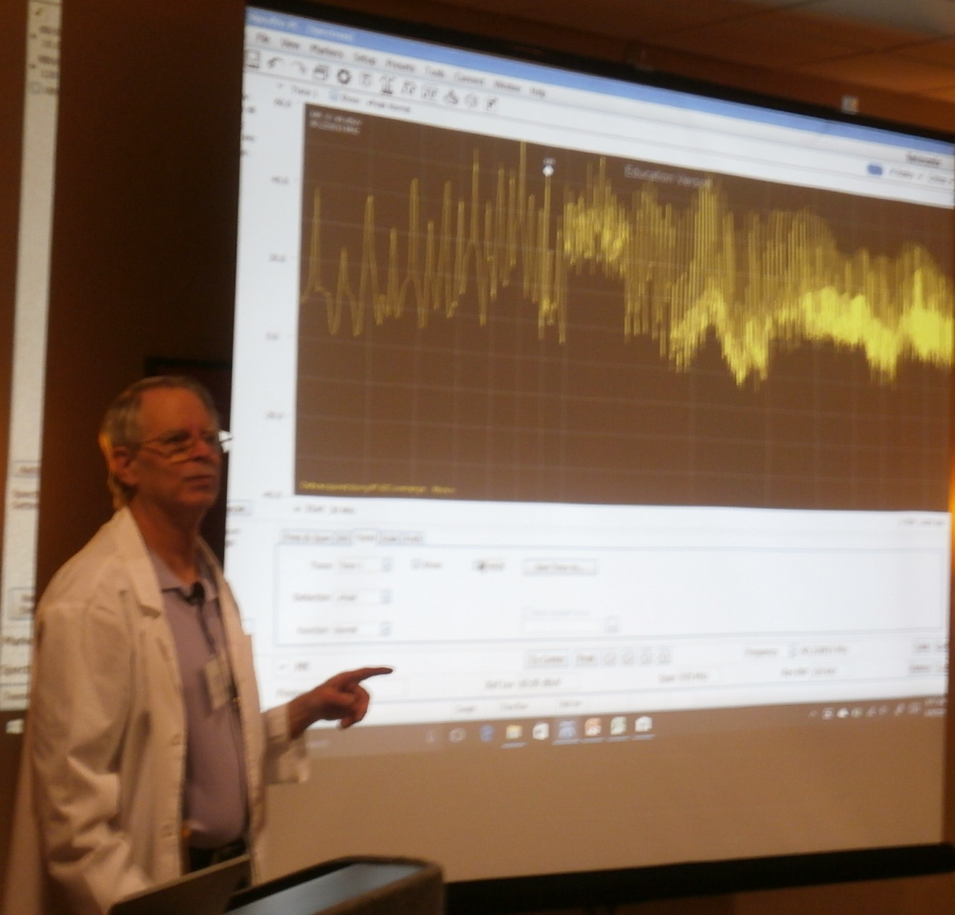
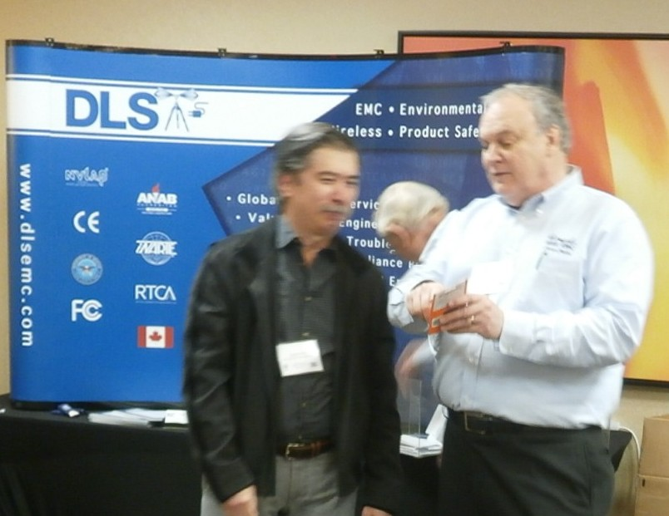
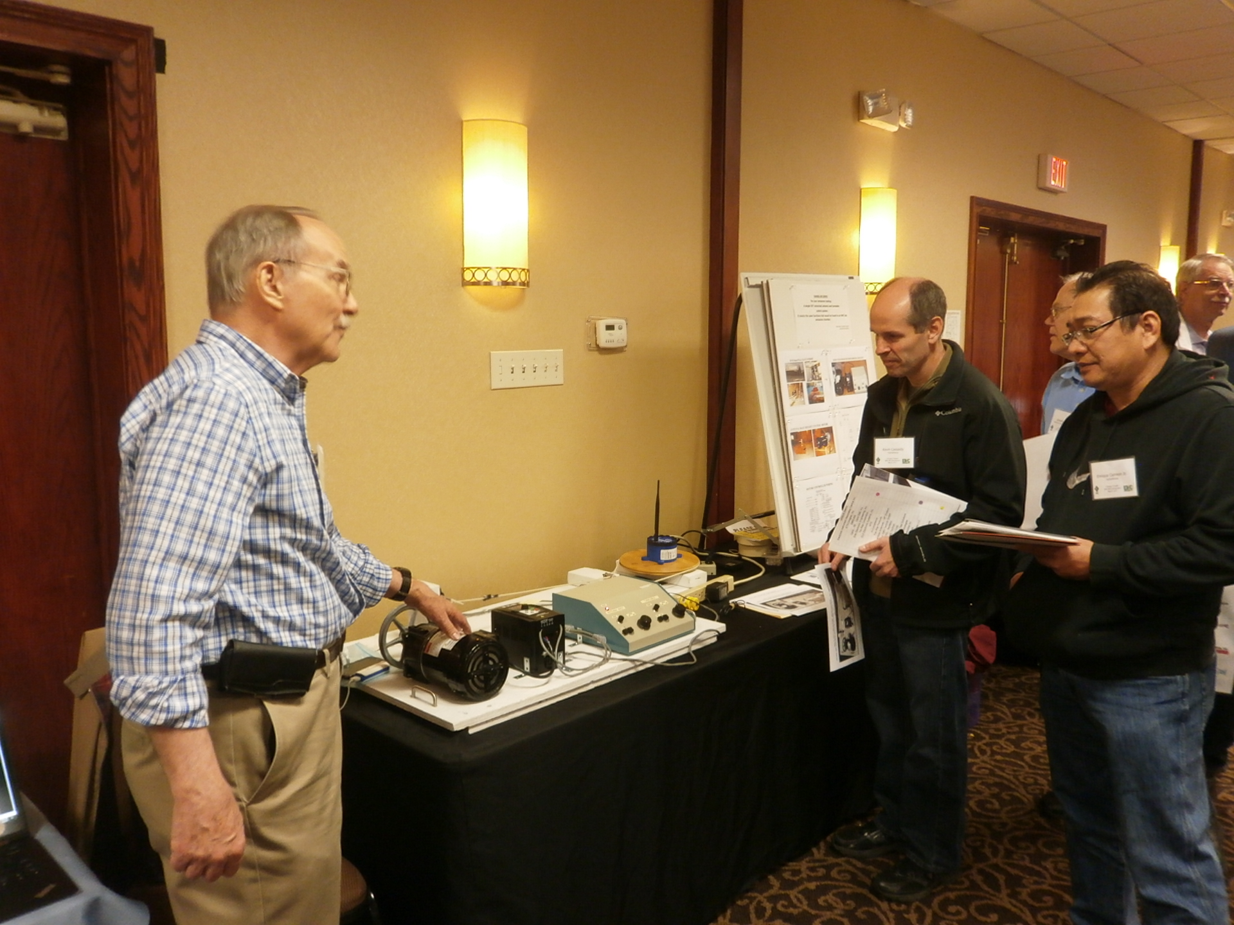
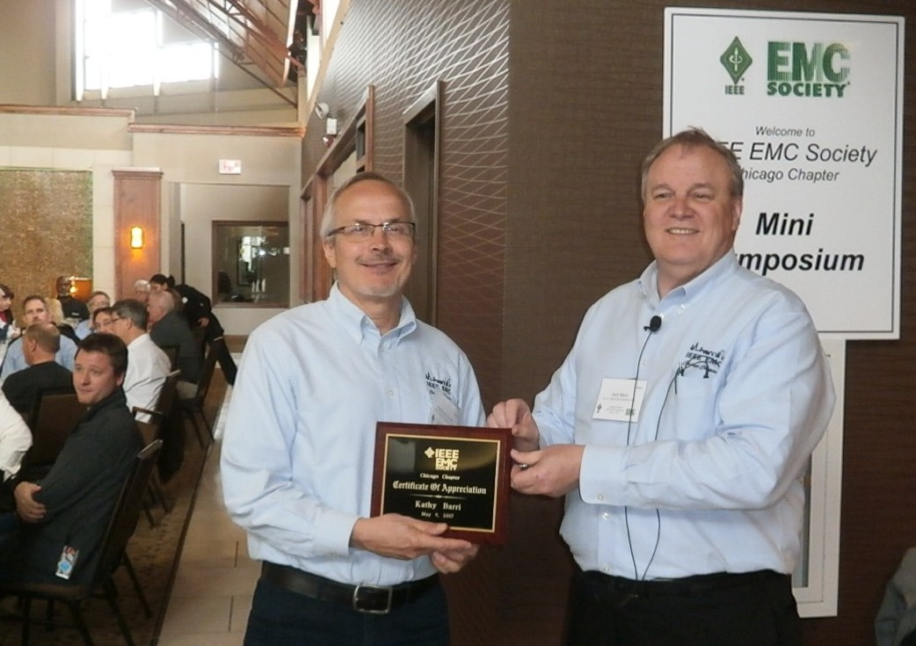
19th Annual Chicago Chapter Mini Symposium May 2017
169 Attendees
Frank Krozel –Chair
Ken Wyatt - Presenter

Slide 15
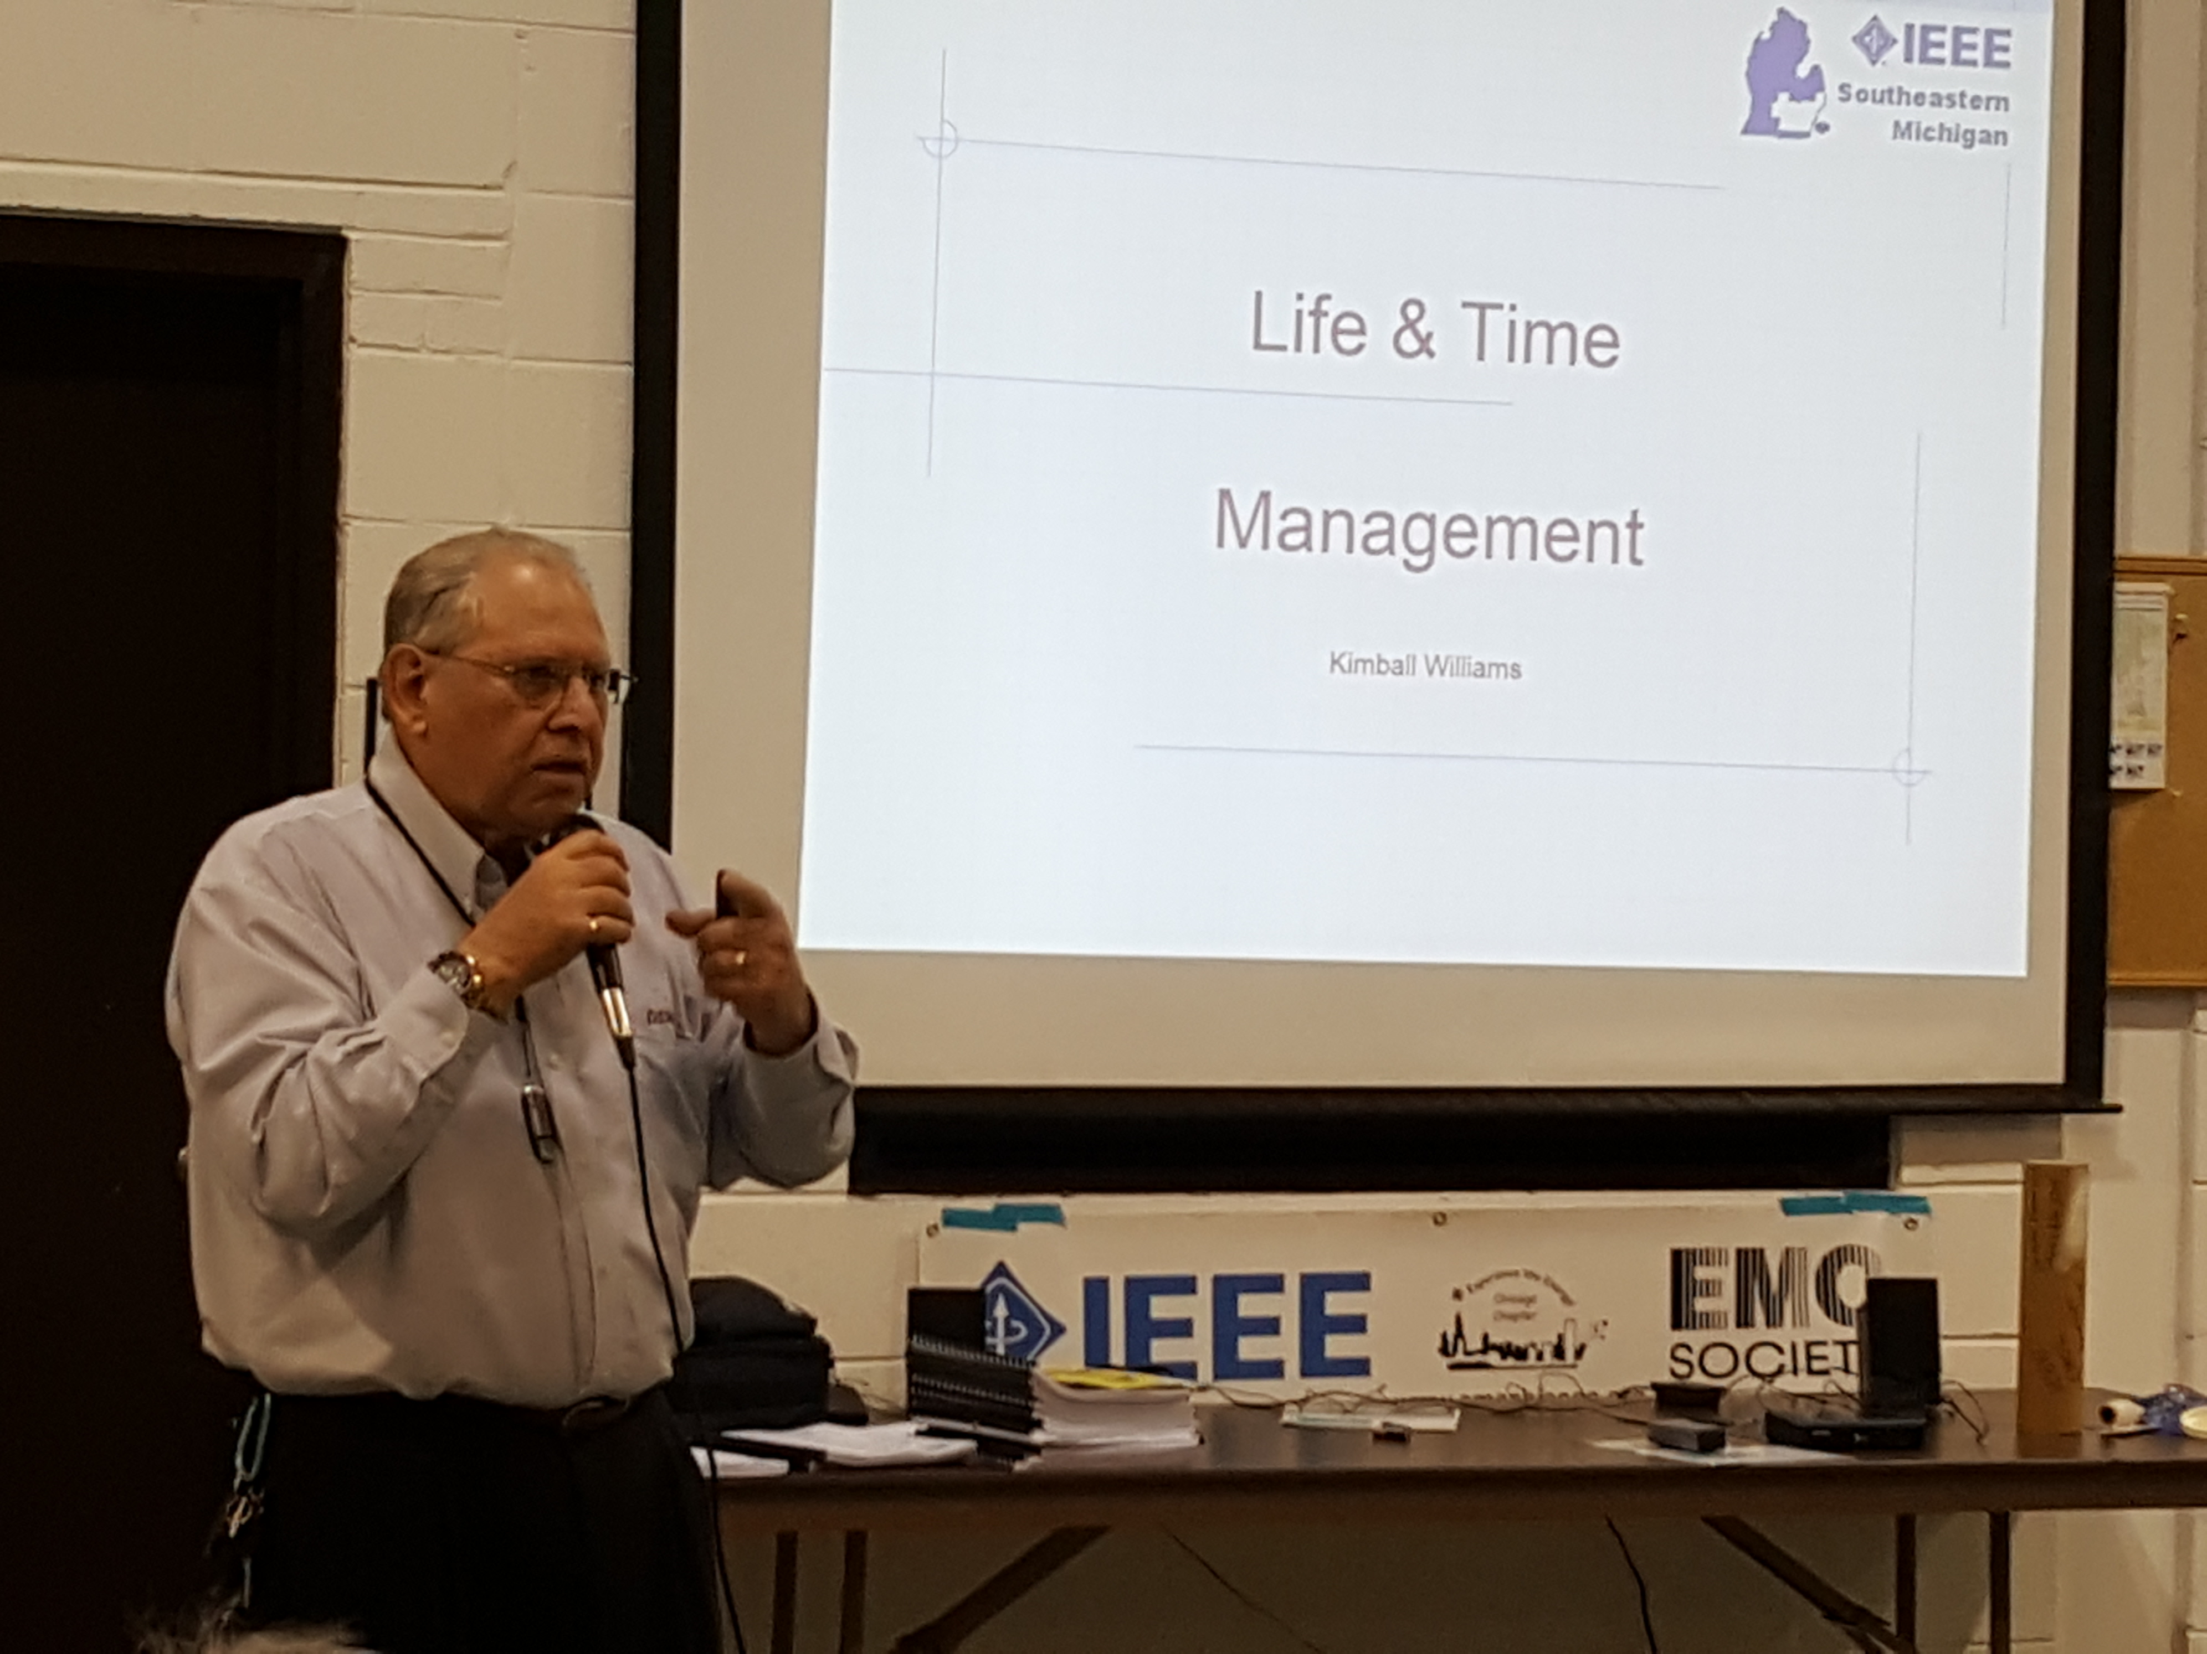
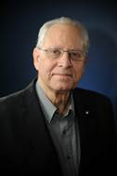
Kimball Williams
IEEE EMC Society
June
Life and Time Management:
A short presentation looking back on 75 years of life, and some suggestions on how to use time and planning to achieve the goals you select and work toward.
Statistical Process Control (SPC) for an EMC Laboratory
43 Attendees

